Slide 2
What is difference between Digital Marketing and Online Marketing ?

Slide 3
What is Digital Marketing?
Digital Marketing refers to the marketing of products and services of a company or business through digital channels such as search engines, websites, email, social media, mobile apps, etc.
It involves the use of electronic devices and the internet..
Digital marketing mainly comprises Search Engine Optimization (SEO), Social Media Optimization (SMO), and Search Engine Marketing (SEM). We can say that it can be divided into three parts SEO, SMO, and SEM. However, Email Marketing and Affiliate Marketing have also become important components of digital marketing over the past few years. So, in digital marketing, we mainly deal with the following components:
SEO
SMO
SEM
Email Marketing
Affiliate Marketing

Slide 4
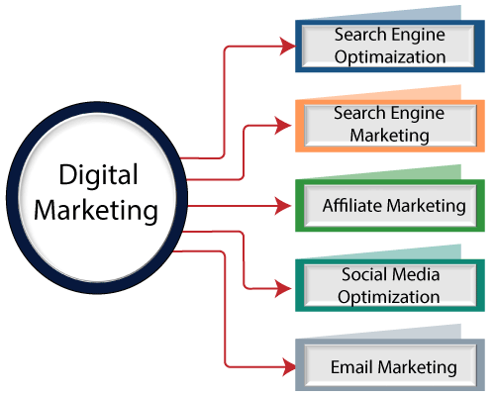
Digital Marketing Components

Slide 5
Let us understand these components of digital marketing one by one:
Search Engine Optimization (SEO):
It is a process of improving the structure and content of your site and doing promotional activities to increase the traffic, and thus ranking on search engine result pages.
Search engine optimization is the process of improving the quality and quantity of website traffic to a website or a web page from search engines. SEO targets unpaid traffic rather than direct traffic or paid traffic.
So, it is a practice of increasing the quantity and quality of traffic to a website through organic search engine results. See the following image to understand the basic activities involved in the SEO.
SEO IS DIVIDED IN TWO PARTS
OFF PAGE SEO
ON PAGE SEO

Slide 6
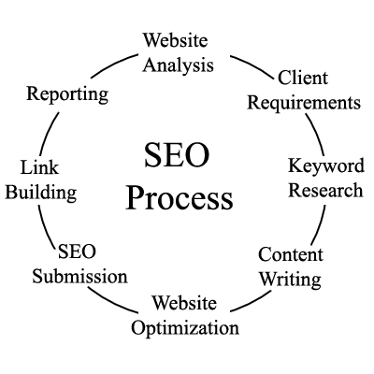

Slide 7
WHAT IS ON PAGE SEO ?
It refers to all the measures or methods used by website owners within their websites to increase the traffic and ranking of a website on search engine result pages.
Within the website means you deal with such elements of SEO that are in your control, such as meta tags, technical tags, content quality, etc.
So, there should not be any delay in resolving on page SEO issues to maintain and improve the ranking.

Slide 8
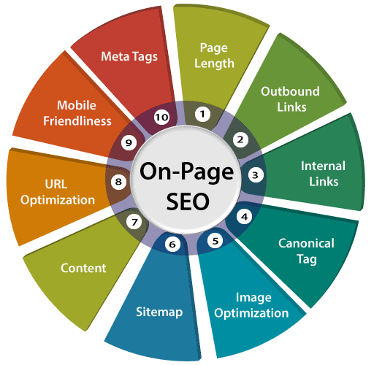
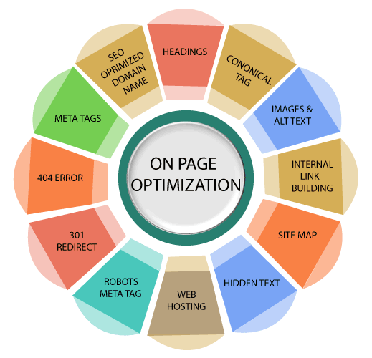
Some of the important On-Page SEO factors are as follows:

Slide 9
How does Search engine works?
Crawling
Indexing
Ranking
Crawling:-
This is the first step in which a search engine uses to find out the webpages on the world wide web.
The web crawler is a program used by google to make an index.
The search engine have the web crawler or spider to visit a web page, read it, and follow the links to the web pages of the sites.
Each time the crawler visits a websites , It makes a copy of the page and adds its URL to the index.

Slide 10
Indexing:-
An index is another name for the database used by a search engine. Indexes contain the information on all the websites that Google (or any other search engine) was able to find. If a website is not in a search engine's index, users will not be able to find it.
Ranking
PageRank is a way of measuring the importance of website pages.
Rankings in SEO refers to a website's position in the search engine results page. There are various ranking factors that influence whether a website appears higher on the SERP based on the content relevance to the search term, or the quality of backlinks pointing to the page.

Slide 11
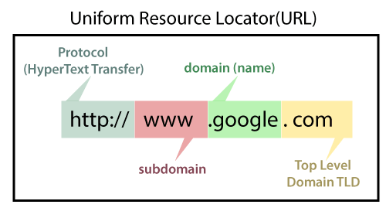
What is Domain Name ?
Domain name is the address of your website that people type in the browser URL bar to visit your website.
In simple terms, if your website was a house, then your domain name will be its address.
A domain name cannot have more than sixty-three characters excluding .com, .net, .org, .edu, etc. The minimum length of a domain is one character excluding the extensions.

Slide 12
Domain Name Types
Top-Level Domains
Country Code Top Level Domains
Generic Top-Level Domains
Second-Level Domains
Third Level Domains
.com – commercial business (the most common TLD)
.org – organizations (typically, nonprofit)
.gov – government agencies
.edu – educational institutions
.net – network organizations
.mil – military

Slide 13
Generic Top-Level Domain (gTLDs) is a generic top-level domain name that identifies the domain class it is associated with (.com, .org, .edu, etc).
Country Code Top-Level Domain (ccTLD) is a two-letter domain extension, such as .uk or .fr, assigned to a country, geographic location or territory.
nTLDs refers to new top-level domain names that are geared towards brands organizations and services, as they’re more customized, flexible and relevant. Examples of nTLDs include “.voyage”, “.app”, “.ninja”, “.cool”, etc.

Slide 14
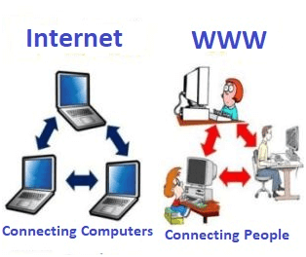
What is World Wide Web?
World Wide Web, which is also known as a Web, is a collection of websites or web pages stored in web servers and connected to local computers through the internet.
These websites contain text pages, digital images, audios, videos, etc. Users can access the content of these sites from any part of the world over the internet using their devices such as computers, laptops, cell phones, etc
Difference between World Wide Web and Internet:

Slide 15
INTERNET | WWW
Internet is a global network of networks. | WWW stands for World wide Web.
Internet is a means of connecting a computer to any other computer anywhere in the world. | World Wide Web which is a collection of information which is accessed via the Internet.
Internet is infrastructure. | WWW is service on top of that infrastructure.
Internet can be viewed as a big book-store. | Web can be viewed as collection of books on that store.
At some advanced level, to understand we can think of the Internet as hardware. | At some advanced level, to understand we can think of the WWW as software.
Internet uses IP address. | WWW uses HTTP.

Slide 16
What is Keyword Research?
Keywords are ideas and topics that define what your content is about. In terms of SEO, they're the words and phrases that searchers enter into search engines.
Keyword research is the process of discovering words and phrases (aka “keywords”) that people use in search engines, like Google, Bing and YouTube.
Why is Keyword Research Important for SEO?
Keyword research impacts every other SEO task that you perform, including finding content topics, on-page SEO, email outreach, and content promotion.

